Slide 1
A Seminar On:
Line Coding
Presented by:
Miss Rina Ahire
ME(ETC)

Slide 2
Objectives:
Need of Line Coding
Introduction of Line Coding
Properties of Line Coding
Types of Line Coding
Advantages and Disadvantages
Power Spectral Density
PSD of Line Coding
Comparison of Line Coding

Slide 3
Need Of Line Coding:
Various Techniques
Other Way: From Computers
Information: Inherently discrete in nature
Transmitted over band-limited channel: Signal gets Dispersed
Causes: Overlap and Distortion
Distortion: Intersymbol Interference(ISI)

Slide 4
To avoid all these problems we are going for
Line Coding

Slide 5
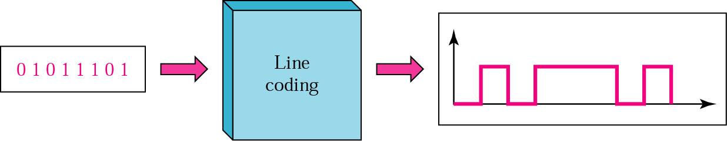
Introduction:
Binary Data: Pulses
Line Coding: A pair of pulses to represent symbols 1 and 0

Slide 6
Properties of Line Coding:
Transmission Bandwidth: as small as possible
Power Efficiency: As small as possible for given BW and
probability of error
Error Detection and Correction capability: Ex: Bipolar
Favorable power spectral density: dc=0
Adequate timing content: Extract timing from pulses
Transparency: Prevent long strings of 0s or 1s

Slide 7
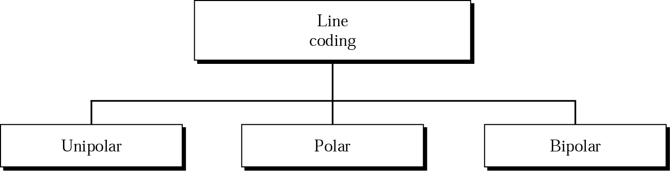
Types of Line Coding:

Slide 8
Unipolar Signaling:
On-Off keying ie OOK
Pulse 0: Absence of pulse
Pulse1 : Presence of pulse
There are two common variations of unipolar signalling:
Non-Return to Zero (NRZ)
Return to Zero (RZ)

Slide 9
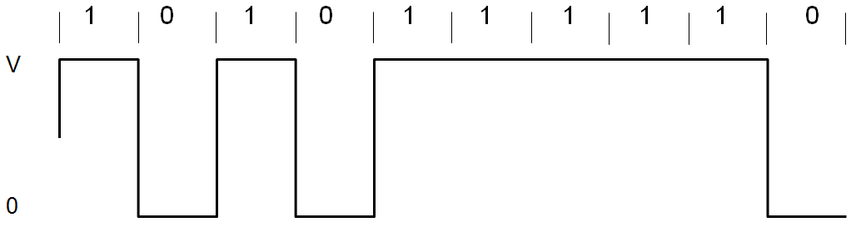
Unipolar Non-Return to Zero (NRZ):
Duration of the MARK pulse (Ƭ ) is equal to the duration (T_{o}) of the symbol slot.

Slide 10
Advantages:
Simplicity in implementation
Doesn’t require a lot of bandwidth for transmission.
Disadvantages:
Presence of DC level (indicated by spectral line at 0 Hz).
Contains low frequency components. Causes “Signal Droop”
Does not have any error correction capability.
Does not posses any clocking component for ease of synchronisation.
Is not Transparent. Long string of zeros causes loss of synchronisation.

Slide 11
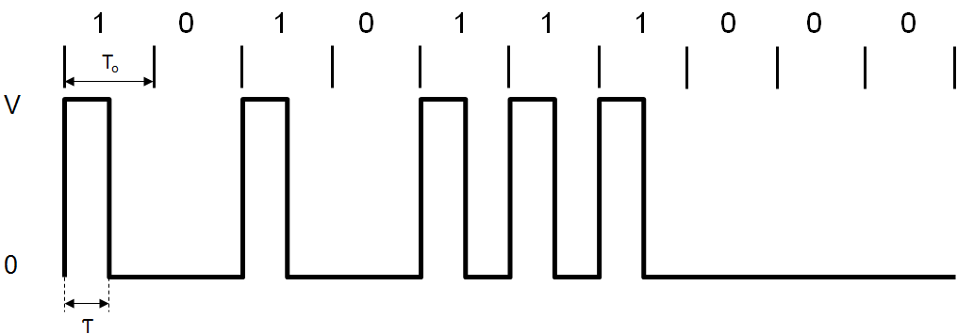
Unipolar Return to Zero (RZ):
MARK pulse (Ƭ ) is less than the duration (T_{o}) of the symbol slot.
Fills only the first half of the time slot, returning to zero for the second half.

Slide 12
Advantages:
Simplicity in implementation.
Presence of a spectral line at symbol rate which can be used as symbol timing clock signal.
Disadvantages:
Presence of DC level (indicated by spectral line at 0 Hz).
Continuous part is non-zero at 0 Hz. Causes “Signal Droop”.
Does not have any error correction capability.
Occupies twice as much bandwidth as Unipolar NRZ.
Is not Transparent

Slide 13
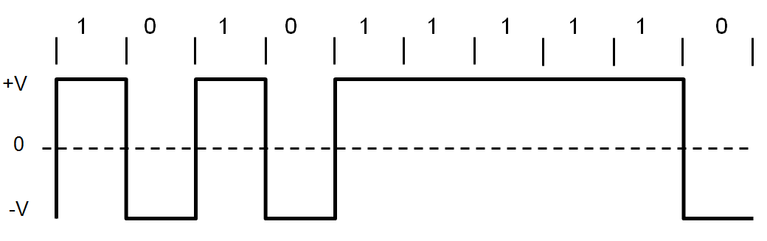
Polar Signalling:
Polar RZ
Polar NRZ
Polar NRZ:
A binary 1 is represented by a pulse g₁(t)
A binary 0 by the opposite (or antipodal) pulse g₀(t) = -g₁(t).

Slide 14
Advantages:
Simplicity in implementation.
No DC component.
Disadvantages:
Continuous part is non-zero at 0 Hz. Causes “Signal Droop”.
Does not have any error correction capability.
Does not posses any clocking component for ease of synchronisation.
Is not transparent.

Slide 15
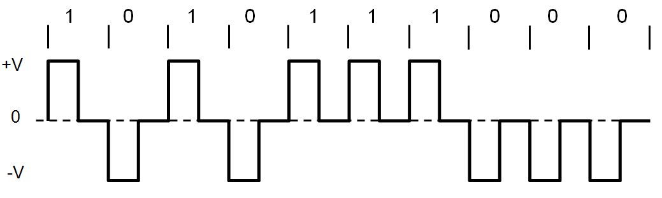
Polar RZ:
A binary 1: A pulse g₁(t)
A binary 0: The opposite (or antipodal) pulse g₀(t) = -g₁(t).
Fills only the first half of the time slot, returning to zero for the second half.

Slide 16
Advantages:
Simplicity in implementation.
No DC component.
Disadvantages:
Continuous part is non-zero at 0 Hz. Causes “Signal Droop”.
Does not have any error correction capability.
Occupies twice as much bandwidth as Polar NRZ.

Slide 17
Bipolar Signalling:
Alternate mark inversion (AMI)
Uses three voltage levels (+V, 0, -V)
0: Absence of a pulse
1: Alternating voltage levels of +V and –V

Slide 18
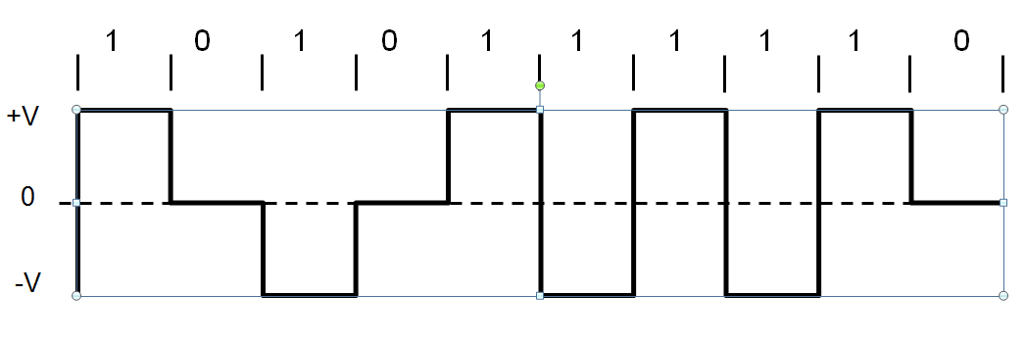
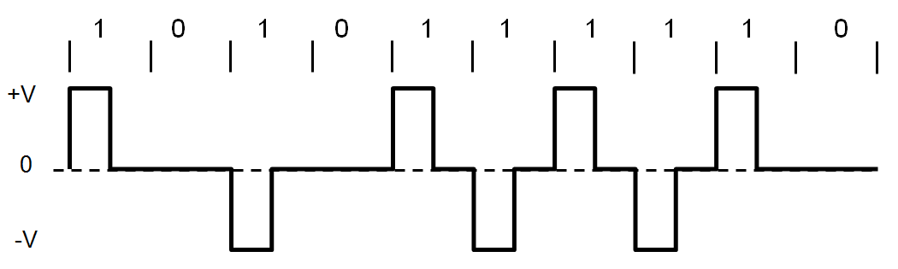
Bipolar NRZ:
Bipolar RZ:

Slide 19
Advantages:
No DC component.
Occupies less bandwidth than unipolar and polar NRZ schemes.
Does not suffer from signal droop (suitable for transmission over AC coupled lines).
Possesses single error detection capability.
Disadvantages:
Does not posses any clocking component for ease of synchronisation.
Is not Transparent.

Slide 20
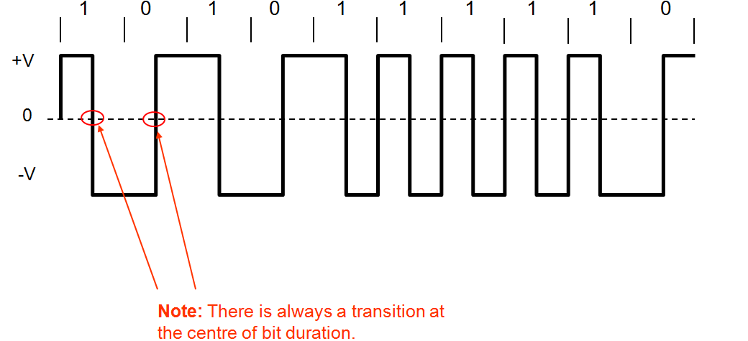
Manchester Signalling:
The duration of the bit is divided into two halves
A ‘One’ is +ve in 1st half and -ve in 2nd half.
A ‘Zero’ is -ve in 1st half and +ve in 2nd half.

Slide 21
Advantages:
No DC component.
Does not suffer from signal droop (suitable for transmission over AC coupled lines).
Easy to synchronise.
Is Transparent.
Disadvantages:
Because of the greater number of transitions it occupies a significantly large bandwidth.
Does not have error detection capability.

Slide 22
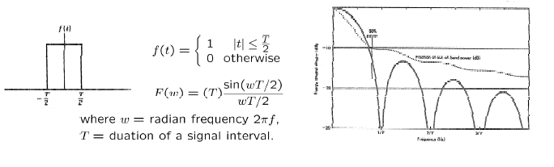
Power Spectral Density:
The function which gives distribution of power of a signal at various frequencies in frequency domain.
PSD is the Fourier Transform of autocorrelation
Rectangular pulse and its spectrum

Slide 23


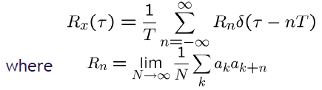


PSD Derivation:
We now need to derive the time autocorrelation of a power
signal x(t)
_--
Since x(t) consists of impulses, is found by
Recognizing for real signals, we have

Slide 24
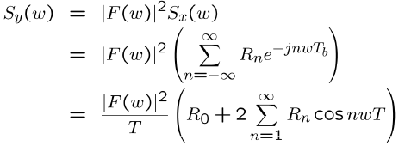
Since the pulse filter has the spectrum of , we have
Now, we can use this to find the PSD of various line codes.

Slide 25


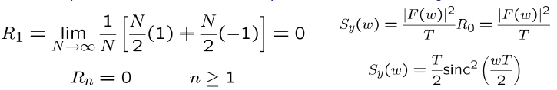
PSD of Polar Signalling:
In polar signalling,
Binary “1” is transmitted by a pulse f(t)
Binary “0” is transmitted by a pulse –f(t)
In this case, is equally likely to be 1 or -1 and is always 1.
Where, There are N pulses and for each one.
The summation on the right-hand side of the above equation is N.
Moreover, both and are either 1 or -1. So, is either 1 or -1.
They are equally likely to be 1 or -1 on the average, out of N terms the product
is equal to 1 for N/2 terms and is equal to -1 for the remaining N/2 terms.

Slide 26



PSD of Bipolar Signalling:
To calculate the PSD, we have
On the average, half of the are 0, and the remaining half are
either 1 or -1, with . Therefore,

Slide 27

To compute R1, we consider the pulse strength product .
-Four possible equally likely sequences of two bits:11,10,01,00.
-Since bit 0 encoded by no pulse , the product for
the last three of these sequences. This means that, on the average,
3N/4 combinations have and only N/4 combinations have
non zero . Because of the bipolar rule, the bit sequence 11
can only be encoded by two consecutive pulse of opposite
polarities. This means the product for the N/4
combinations.

Slide 28
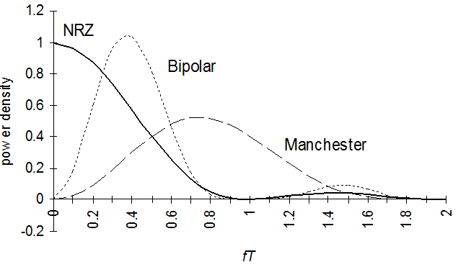
PSD of Lines Codes:

Slide 29
Comparison of Line Codes:
Sr. No. | Parameters | Polar RZ | Polar NRZ | AMI | Manchester
1 | Transmission of DC component | YES | YES | NO | NO
2 | Signaling Rate | 1/Tb | 1/Tb | 1/Tb | 1/Tb
3 | Noise Immunity | LOW | LOW | HIGH | HIGH
4 | Synchronizing Capability | Poor | Poor | Very Good | Very Good
5 | Bandwidth Required | 1/Tb | 1/2Tb | 1/2Tb | 1/Tb
6 | Crosstalk | HIGH | HIGH | LOW | LOW

Slide 30
Thank You

